Slide 1
CSE110
Programming Language I

Slide 2
My Brief Profile
Nahian Salsabil (NNS)
Lecturer, CSE, BRACU
BSc: CSE, BUET, 2023
Email: nahian.salsabil@bracu.ac.bd
Room No. UB80601
Consultation Hour:
Sunday: 11:00am - 1:30pm
Monday: 9:30am - 10:50am
Wednesday: 9:30am - 10:50am

Slide 3
Links
Resources: http://tiny.cc/cse110_resources_NNS
Slide: http://tiny.cc/cse110w1_NNS
Slack: http://tiny.cc/cse110_slack

Slide 4
Why should we learn programming?
To solve problems
Computers are fast
Computers do exactly what you tell them to do

Slide 5
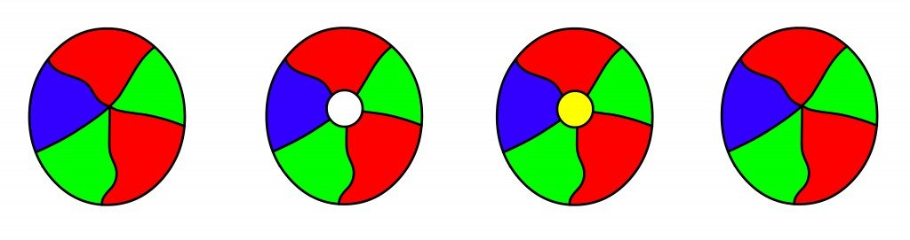
Why should we learn programming?
To solve problems
Four Color Map Theorem

Slide 6
Why should we learn programming?
Career Opportunities
Software Developer
Web Developer
Server Admin
Database Admin
Data Analyst
Cyber Security Expert

Slide 7
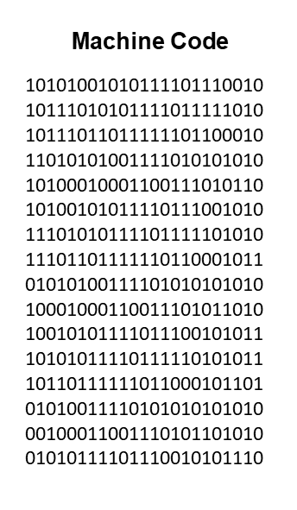
Computers can only understand 0’s and 1’s
Computers only understand the Machine Language
Hard to code for humans
Solution?
High level programming languages
Example: Python, C, Java etc.

Slide 8


Python
A popular programming language
Created by Guido van Rossum
Released in 1991

Slide 9
Why Python?
Syntax is simpler than that of other languages
Takes fewer lines to code
Works on different platforms such as Windows, Linux, Mac etc.
Runs on an interpreter system

Slide 10
Outline
Variables
Variables Naming Convention
Data Types
print()
Keywords
Declaring Variables
Deleting Variables
Operators

Slide 11
A Simple Python Code
print(“I like Python programming!”)

Slide 12
Variables
A python variable is a reserved memory location to store values
Variables can be anything following the naming conventions
a = 2
b = 5
c = a + b
print(c)

Slide 13
Variable Data types
Integer: a = -5
Float: b = 2.55
String c = “This is a string”
List li = [“Hello”, “Python”, “Programmer”]
Tuple tu = (“Hello”, “Python”, “Programmer”)
Boolean b = True, f = False

Slide 14
type()
To learn the data type of any variable in Python, just use type(variable_name)
x = 5
y = 7.8912
z = “I love Python!”
p = [1, 2, 3]
print(type(x))
print(type(y))
print(type(z))
print(type(p))
Output:
<class ‘int’>
<class ‘float’>
<class ‘str’>
<class ‘list’>

Slide 15
Variable Naming Convention
Begin with lowercase letters. For example,
cat = “Tom”, pi = 3.14
Separate the words in a variable with an underscore (_). For example,
my_cat = “Tom”, total_sum = 3.79
Alternatively, you may capitalize the next words. For example,
myCat = “Tom”, totalSum = 3.79
Never start a variable name with digits or dollar signs. For example,
$my_cat = “Tom”, 0totalSum = 3.79
Variables names are case sensitive i.e. mycat and myCat are different variable names.

Slide 16
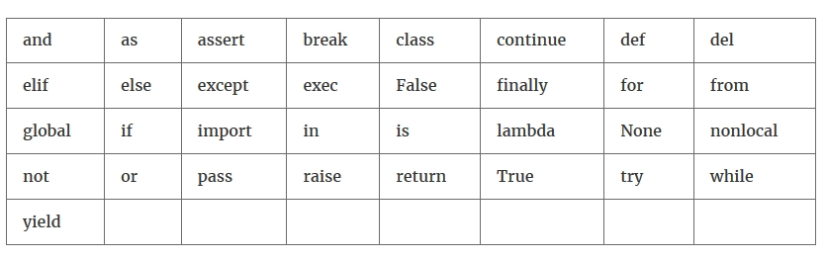
Keywords in Python

Slide 17
Declaring Variables
Syntax: variable name = value
Variables in Python are dynamically typed. For example,
s = “I love CSE”
print(type(s))
s = 2023
print(type(s))
Output:
<class ‘str’>
<class ‘int’>

Slide 18
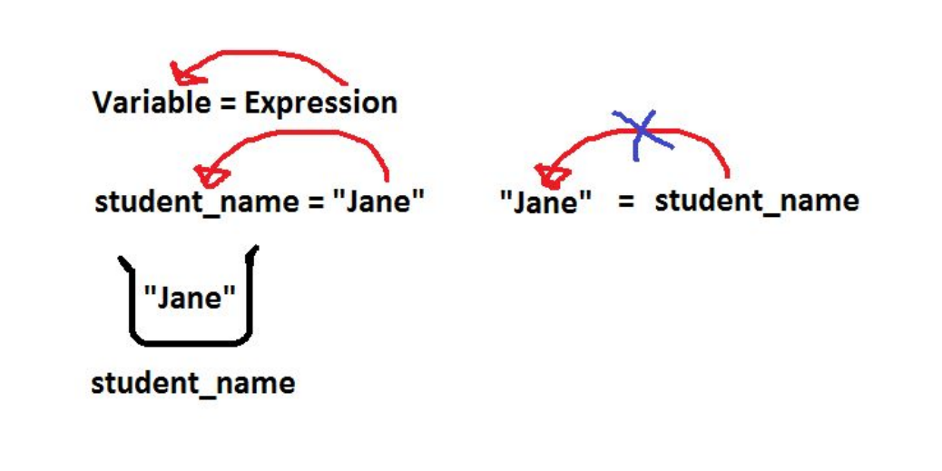
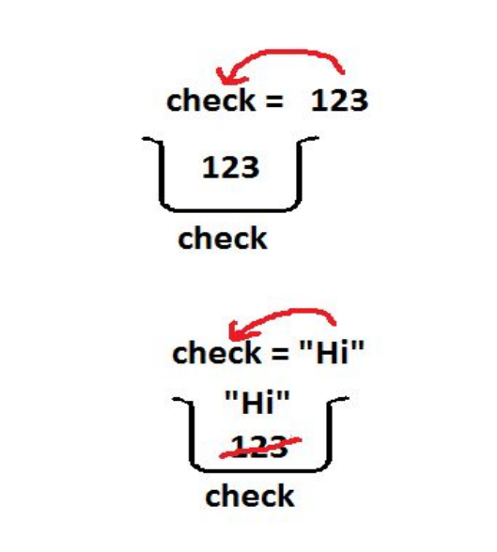
Variables Continued

Slide 19
Deleting Variables
x = 2
del x
print(x)
Output:
NameError: name ‘x’ is not defined

Slide 20
Operators
Unary
Unary Plus
Unary Minus
Binary
Addition (+)
Subtraction (-)
Multiplication (*)
Division (/)
Floor Division (//)
Modulus (%)
Exponential (**)

